Slide 1
Interactive
Science
Notebooks
(ISN)
Mrs. Goodale Science 7

Slide 2
Have you ever heard yourself say ... ?
I can't remember what
we did in class yesterday.
I can't find my . . .
notes, homework, quizzes . . .
I'm sure it’s in . . .
my locker? my book bag? my room?
I was absent last week,
did I miss anything?

Slide 3

No worries …
Turn those frowns
upside down …
Interactive Science
Notebooks
are here to save the day!

Slide 4
What Is An Interactive Science Notebook?
An interactive science notebook (ISN) is your own personalized SCIENCE BOOK.
A portfolio of your work in ONE spot that you bring EVERY DAY. This is a great resource for STUDYING for quizzes & tests.
A great ORGANIZATIONAL tool that gives you permission to be COLORFUL and CREATIVE to show me what you know or have learned.
Allows you to be like a REAL SCIENTIST by asking QUESTIONS, RECORDING what you observe, and SHARING it with your classmates!
Source: Gretchen Vikingson at http://vikingson.edublogs.org/files/2011/07/2011-2012-INB-student-version-2afd6sb.ppt

Slide 5



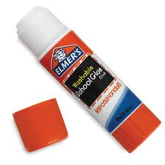
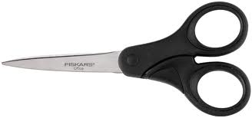
Science Notebook Supplies
Colored Pencils
Pens & Pencils
Spiral Notebook
Scissors
Glue Stick
NO MARKERS!

Slide 6

The ISN is divided into TWO sections:
Left Side
Right Side
“LOVES” YOUR work. This is the side that you can use to show me what you learned
in a creative and colorful way.
This is the “output” or product side.
Even-numbered pages
“RESTRICTED” to
Mrs. Goodale’s input work
Contains info my teacher tells me to “ADD” or “WRITE”
This is the “input” side or info side.
Odd-numbered pages
Source: Gretchen Vikingson at http://vikingson.edublogs.org/files/2011/07/2011-2012-INB-student-version-2afd6sb.ppt

Slide 7
What Goes Where?
Left Side
Student Output
Lots of Color, Diagrams, & Doodles
Concept Maps/Organizers
Drawings
Reflective Writing
Questions
Data Charts and Graphs
Songs, Poems, or Riddles
Data from Experiments
Cartoons or cartoon strips
Right Side
Teacher Input/Content
Blue/Black Ink or Pencil
Information given in class
Lecture Notes
Lab Activities
Video Notes
Summaries
Textbook Notes
Procedures for experiments
Classroom Specific Information
Source: http://www.slideshare.net/arholder/interactive-science-notebook-full-version

Slide 8
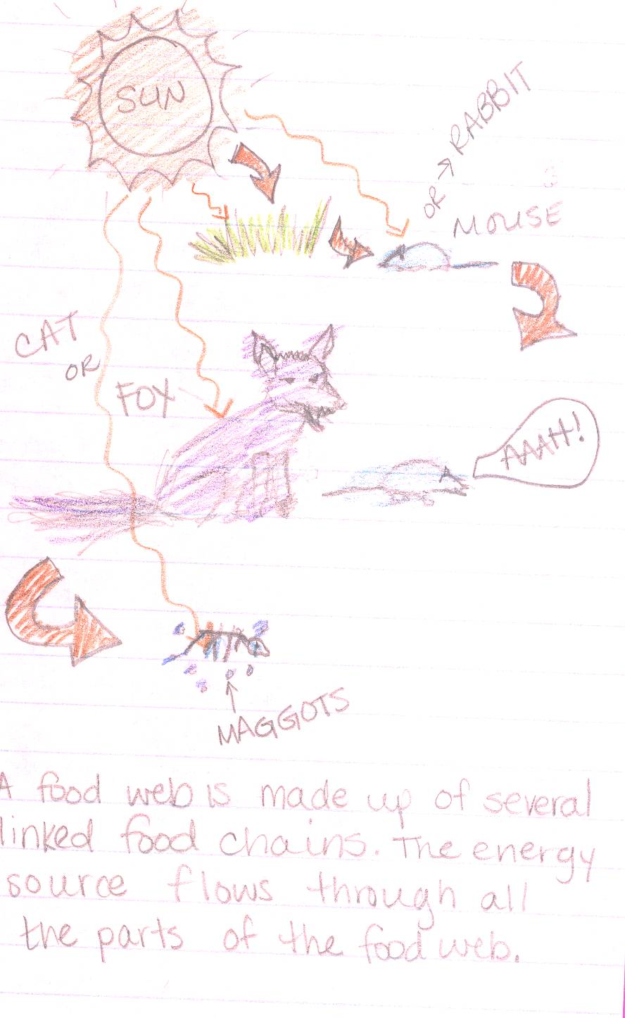
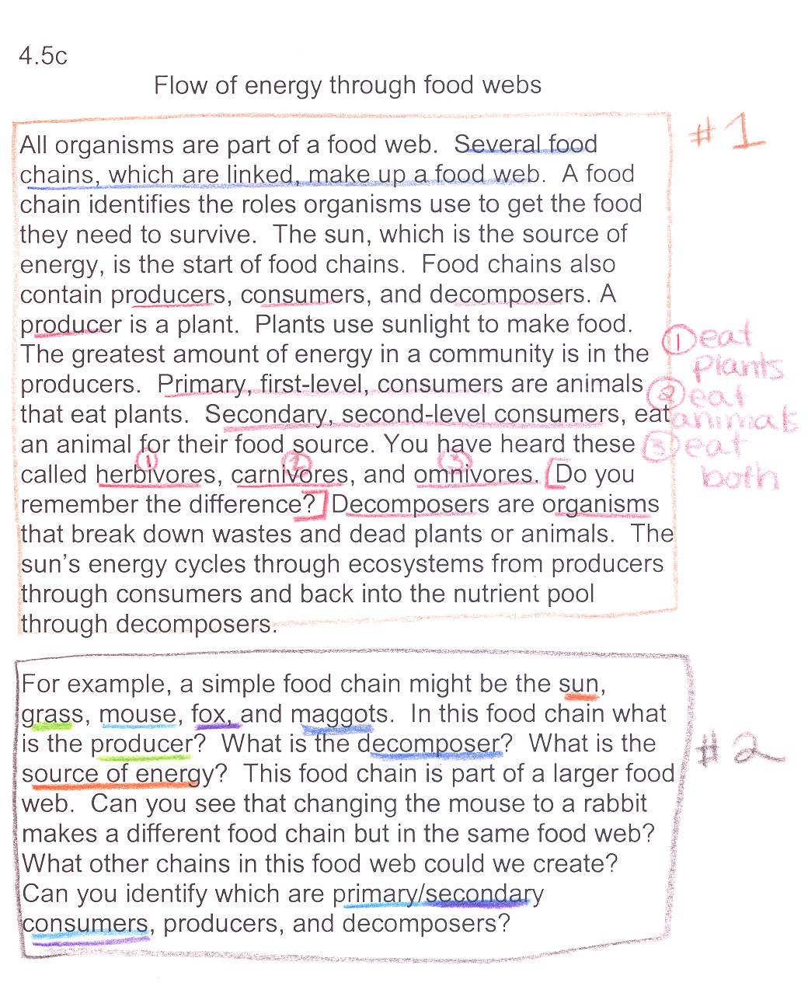
Example page:
OUTPUT
(your interpretation)
INPUT
(notes from teacher)

Slide 9
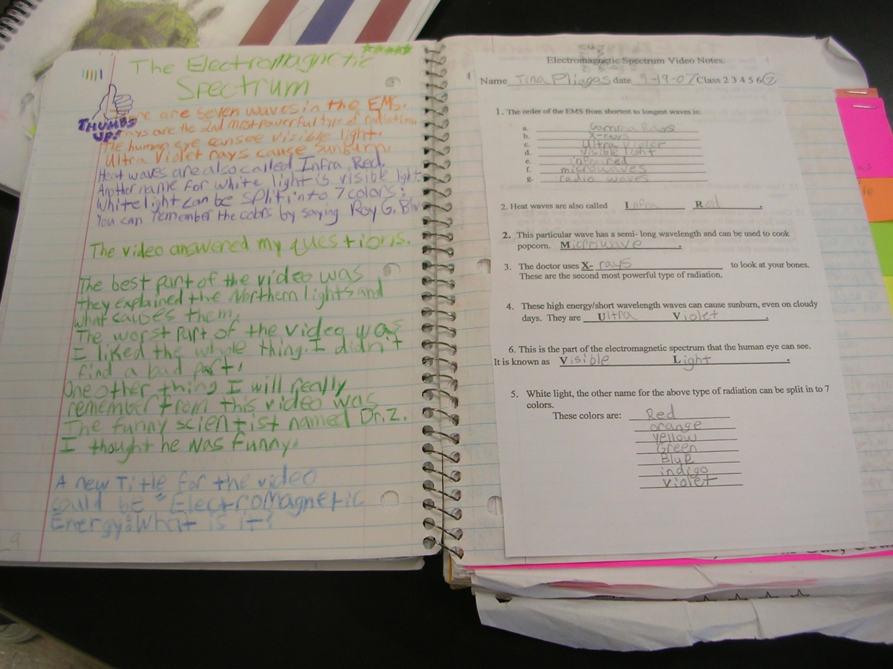
OUTPUT
(your interpretation)
INPUT
(notes from teacher)
Source: http://www.slideshare.net/arholder/interactive-science-notebook-full-version

Slide 10

Page Numbers
Add PAGE NUMBERS for the first 50 pages.
Start with 1 in the bottom-right corner of the first page following the Table of Contents, follow with a 2 on the back of that page and so on.
EVENS
ODDS

Slide 11
Notebook Rules
Do not RIP OUT pages or tear corners.
All handouts MUST BE GLUED IN!
Please don’t DOODLE unless it relates to science.
Your ISN should only be used for SCIENCE CLASS and COMES TO CLASS EVERYDAY!
Each page should have the DATE and PAGE#.
BE COLORFUL, CREATIVE, & LOVE YOUR NOTEBOOK!
Source: Gretchen Vikingson at http://vikingson.edublogs.org/files/2011/07/2011-2012-INB-student-version-2afd6sb.ppt

Slide 12
QUESTIONS?

Slide 13
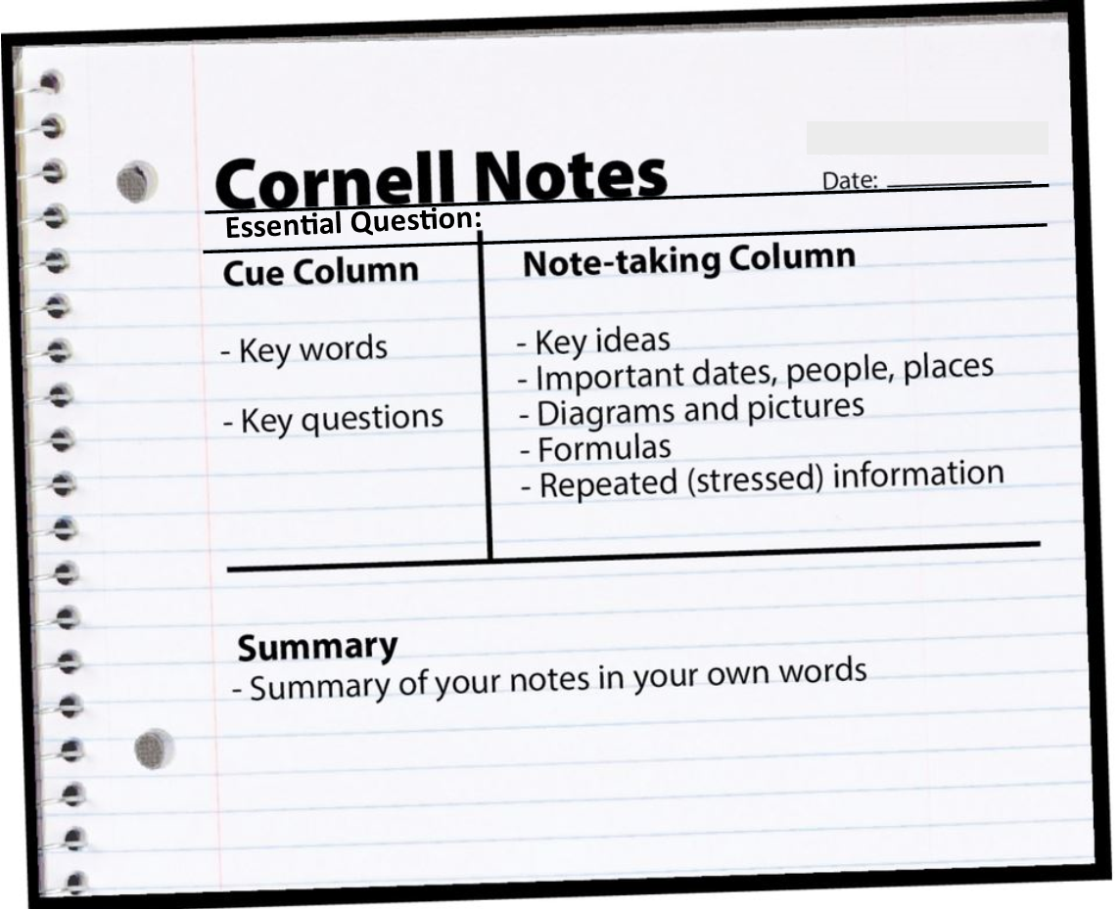
Cornell Notes
(C-NOTES)

Slide 15
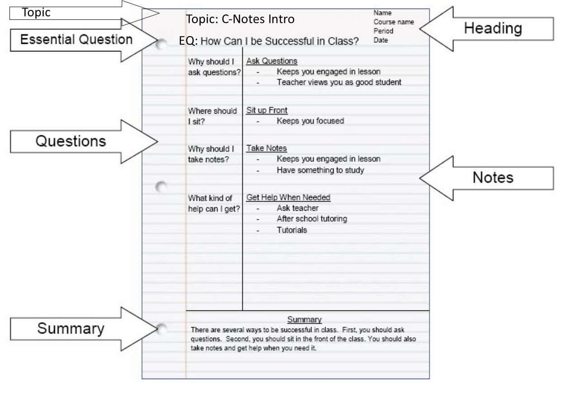
C-Notes

